Slide 1
UI & Schedule Format for Auto Box Test
Version 1.07

Slide 2
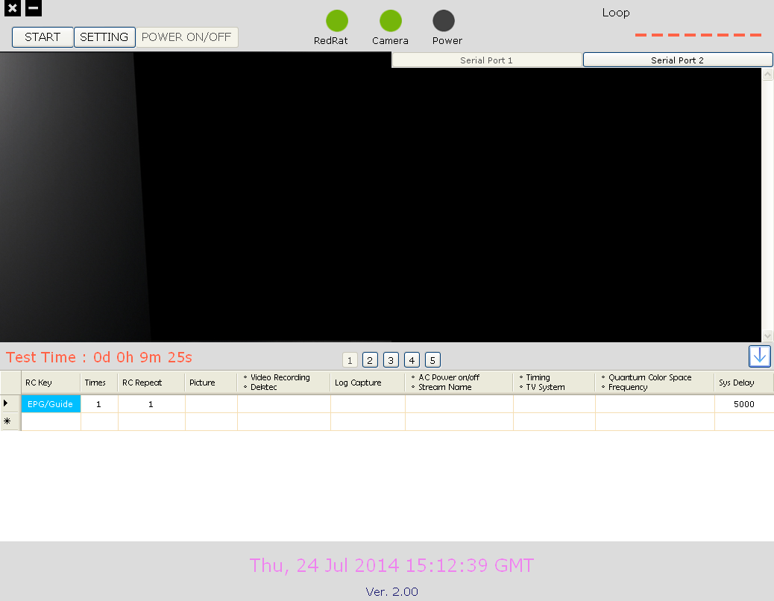
UI Introduction - Main Screen
Start stress test
Enter setting page
Change Serial port
Camera
Log
Save as schedule file
Switch Schedule
Test time of schedule
Schedule Command

Slide 3
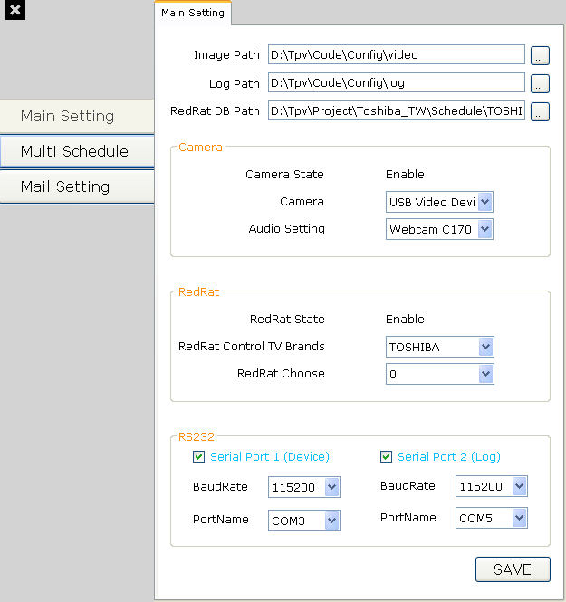
UI Introduction – Main Setting
Select location to save photo and log, load RC DB.
Camera setting, select your camera device.
RedRat setting, select RedRat database.
Secord RS232 setting, select your comport and baudrate.
press “SAVE” button to save date

Slide 4
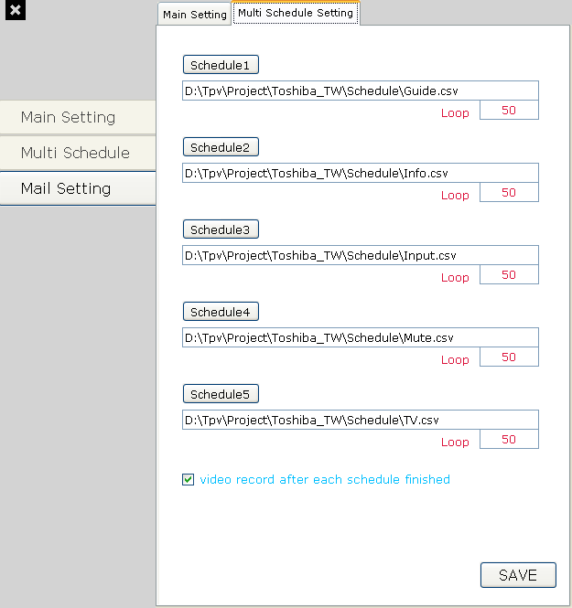
UI Introduction – Multi Schedule Setting
Press to load schedule file.
Setting how many times to test for a schedule.
video record after each schedule finished.
press “SAVE” button to save date

Slide 5
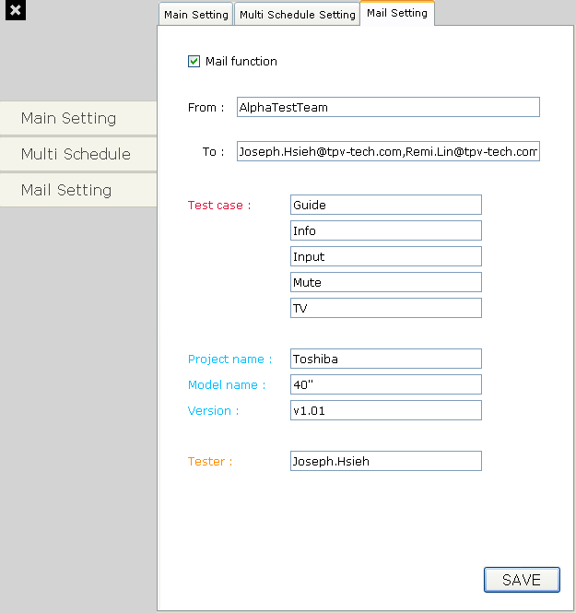
UI Introduction – Mail Setting
Enable or not to send mail after stress test finished.
If you enable it, [Form] and [To] must be filling in data.
Filling in information for mail.
press “SAVE” button to save date

Slide 6
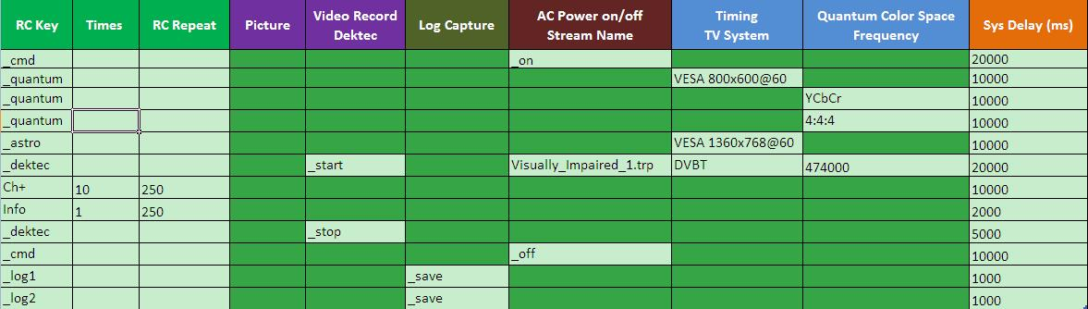
Schedule Example
System Setting :
Working folder setting
Input the schedule description
Execute by test times
Soft Remind:
Please use Script Template V2.00a.xlsx to edit Schedule
If want use old Schedule, please transform new format

Slide 7
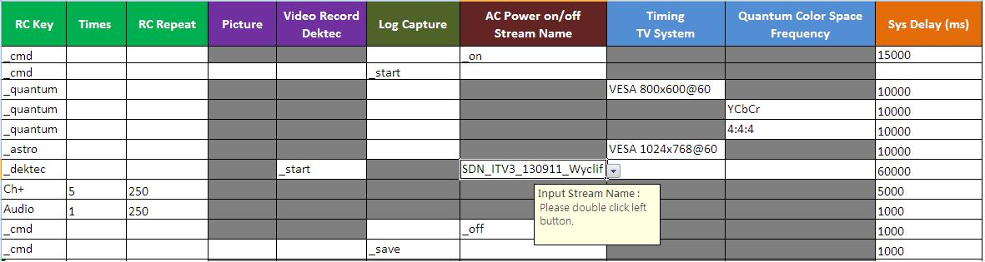
Define RC Key for Equipment Operation
Select RC key from pull-down list
“_quantum” or “_astro” is reserved for Auto Stress Test Equipment Control Command
Select Timing from pull-down list
Change color space for Quantum, can select from pull-down list
Define how many times this RC key is repeated
no repeat if empty
set stream to play, click twice can fill stream name
Define waiting duration before next RC key step
0 ms if empty

Slide 8
Define RC Key Operation
Select RC key from pull-down list
“_cmd” is reserved for Auto Stress Test System Control Command
Define waiting duration after each RC key sent
0 ms if empty
RC Key | Times | RC Repeat (ms) | … | Sys Delay (ms)
Menu | 1 |  | … | 300
Exit |  |  | …
Vol+ | 3 | 100 | … | 1000
Ch+ | 2 | 3000 | … | 300
Define how many times this RC key is repeated
no repeat if empty
Define waiting duration before next RC key step
0 ms if empty

Slide 9

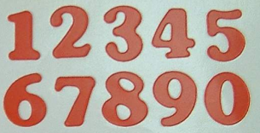
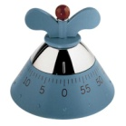
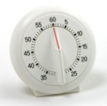





RC Key Operation Spec
RC Key | Times | RC Repeat (ms) | … | Sys Delay (ms)
Menu | 3 | 250 | … | 2000
NEXT RC
Menu
Menu
Menu

Slide 10
Define System Control Operation
“_cmd” is System, ”_log1; _log2” for COMport use, not RC key
Record Video/Audio
“_start”, “_stop”
System Power
“_on”, “_off”
Take a picture
“_shot”
Record RS232 message, by “_save”
Clear message by “_clear”
Except with “_” prefix, all text is sent to TV, “Enter” key is added automatically
Waiting time
0 ms if empty

Slide 11
Trouble Shooting
Environment check:
File path/directory path are correctly set
Disable “Power saving” settings in PC/NB so that Auto Test won’t be affected by HD or peripheral power-down
I cannot find the RC key I need from pull-down list
Please report to RC database administrator
No Response on TV
Please make sure all indicators are correct
Please make sure RC protocol is set correctly
RC Key operation is lost occasionally
Duration of RC repeat and Sys delay should be sufficient for TV operation
The response time of TV is various over different RC and TV models
It is recommended to execute RC operation manually before setting RC repeat and Sys delay
Equipment connect to Auto box
ASTRO VG871-B/ VG872-C and Quantum 882/ Dektec Gold-215

Slide 12
Trouble Shooting
6. Multi Schedule:
Can set 5 schedules in stress test
Shorten the time
7. Mail system:
When test finish can send Mail to personnel

